Slide 1



What factors can
predict re-admission to a hospital?
Surabhi Damle, Manasa Tandri, Nandini Gupta, Girija Joshi

Slide 2




Background
Initial Data Analysis
Modeling
Findings
Limitations
Future Recommendations
Questions
AGENDA

Slide 3
Background
Back to Agenda
Dataset: interactions with diabetes patients
1999-2008
Represents 130 US hospitals and integrated delivery networks
Captures “encounters”: patient stayed for up to 14 days, underwent labs & medications
03
01
02
Arbitrary/poor diabetes management
High rates of patient readmission:
46.08 %
Higher risk of death
Higher patient costs & hospital expenditures
Understand systemic causes of readmission reduce readmission in the future.

Slide 4
Back to Agenda
Back to Agenda
Initial Data Analysis
Variables explored through visualization:
Readmitted Status of Patient Encounters in the Dataset, by Race
Readmitted Status of Patient Encounters in the Dataset, by Gender
Readmitted Status of Patient Encounters in the Dataset, by Age
Readmitted Status of Patient Encounters, by Discharge Type
Readmitted Status of Patient Encounters, by Time Spent in Hospital

Slide 5
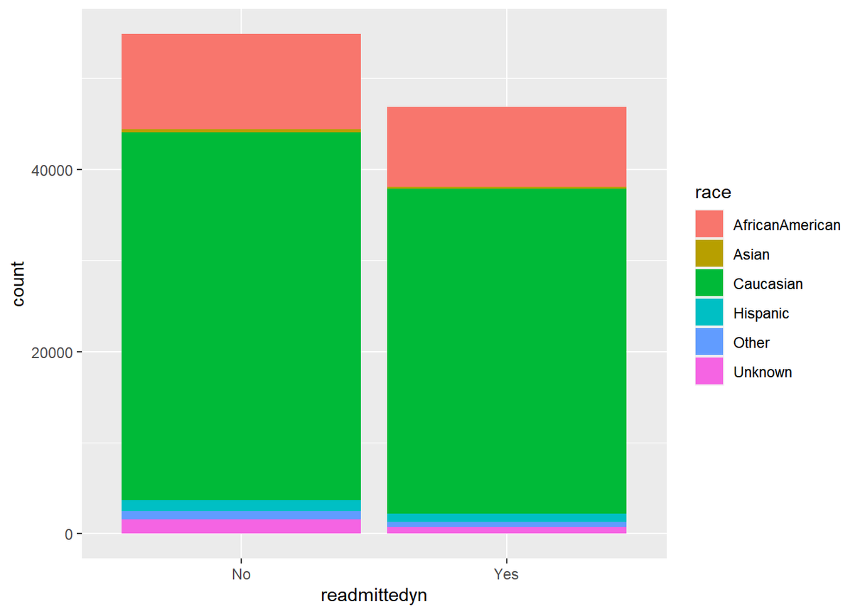
Back to Agenda
Initial Data Analysis
Back to Agenda
Readmitted Status of Patient Encounters in the Dataset, By Race

Slide 6
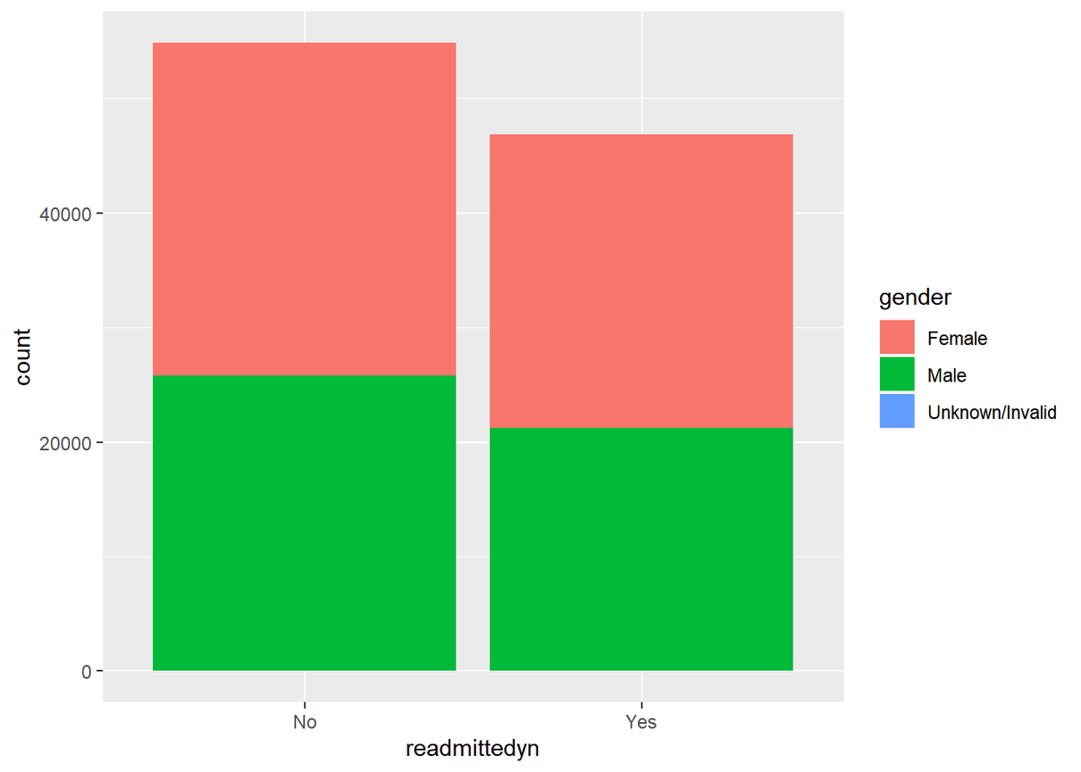
Back to Agenda
Back to Agenda
Initial Data Analysis
Readmitted Status of Patient Encounters in the Dataset, By Gender

Slide 7
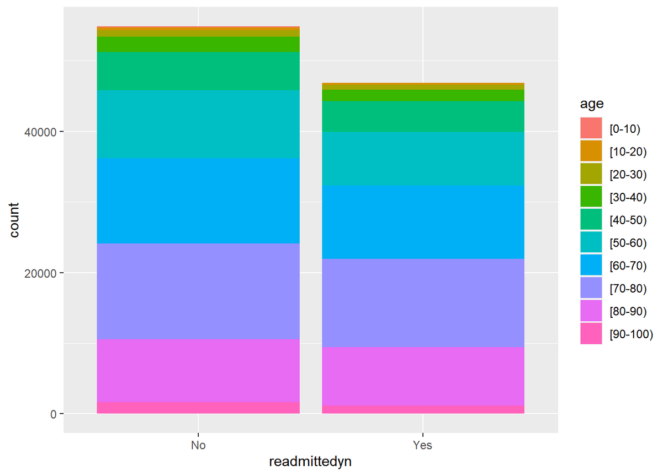
Back to Agenda
Back to Agenda
Initial Data Analysis
Readmitted Status of Patient Encounters in the Dataset, By Age

Slide 8
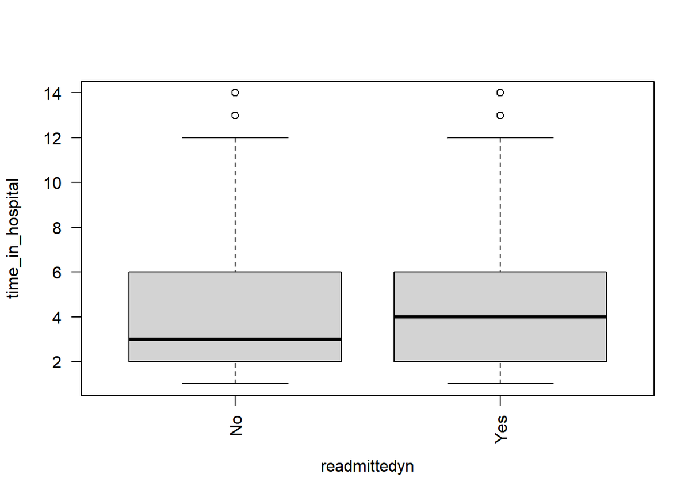
Back to Agenda
Back to Agenda
Initial Data Analysis
Readmitted Status of Patient Encounters in the Dataset, By Time in Hospital
Median time in hospital is larger for individuals who were readmitted.

Slide 9
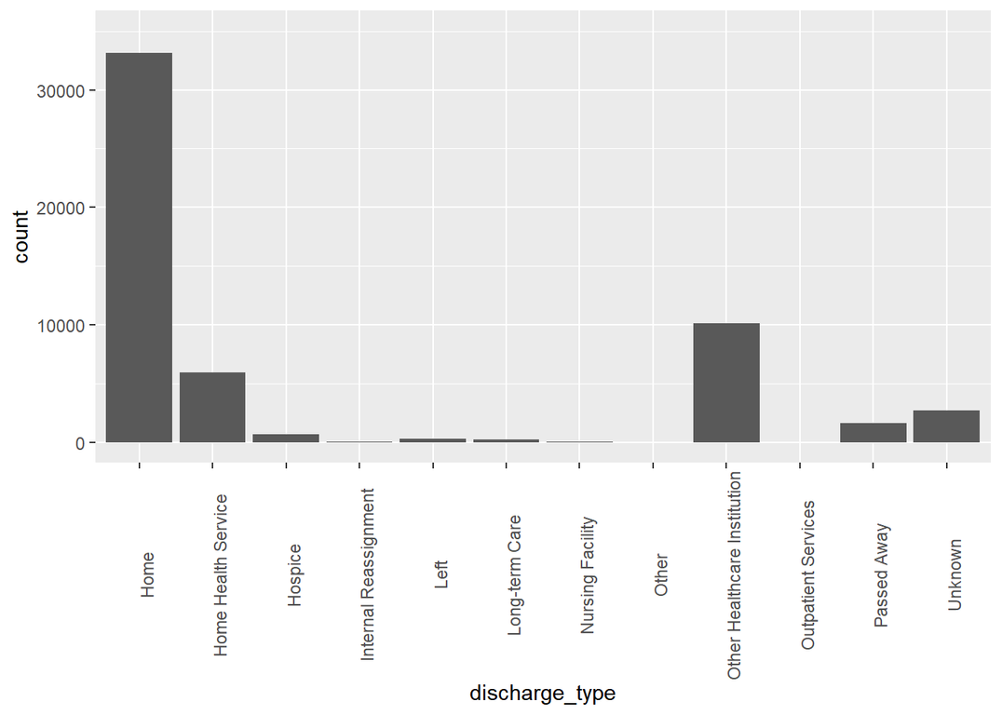
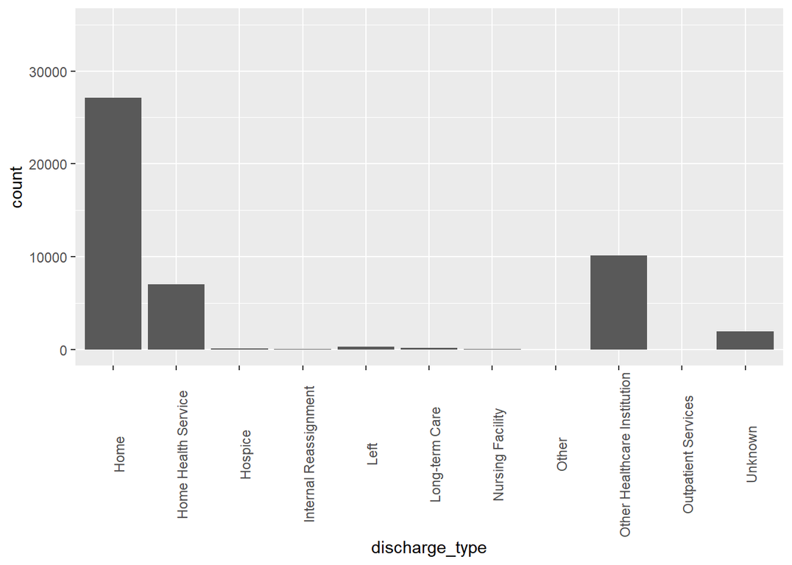
Back to Agenda
Back to Agenda
Initial Data Analysis
Non-readmitted indivduals, by discharge type
Readmitted indivduals, by discharge type

Slide 10

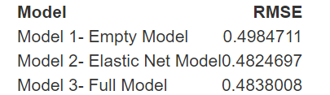
Back to Agenda
Predictive Model
01
Empty Model
02
Elastic-Net Model
03
RMSE (root mean squared error) ~0.5 for all 3 models.
Full Model

Slide 11
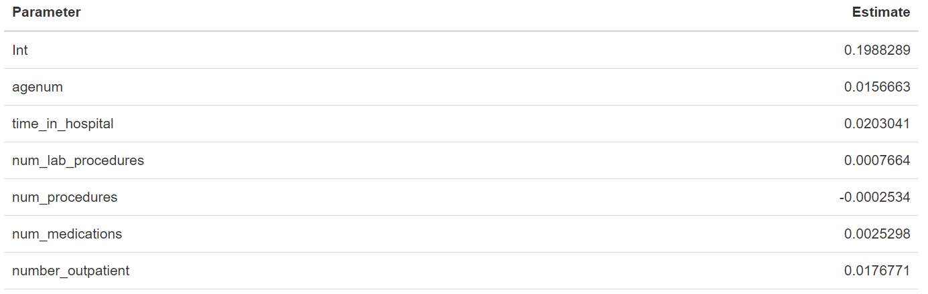
Back to Agenda
Elastic Net Model Predictors

Slide 12

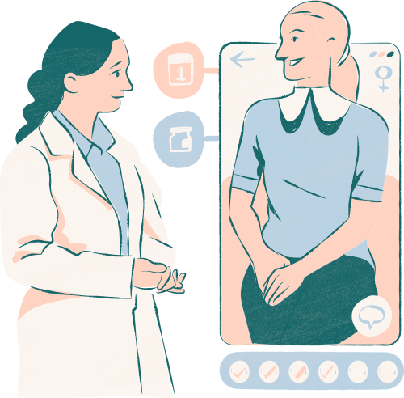
Findings
Variables chosen in models are not good predictors of readmittance
Empty model had similar error to other models
Boxplot shows that those that were readmitted spent about 1 more day in the hospital
Back to Agenda

Slide 13
Back to Agenda
Limitations
Not accounting for past medical history
Missing Data
Categorical data converted into binary
Normalization

Slide 14

Back to Agenda
Back to Agenda
Future Recommendations
Modeling based on individual drugs as predictors
Modeling based on health insurance coverage (known predictor)
Using models accommodating mixed-type data such as KPrototypes Clustering Algorithm
Analyzing dataset based on individuals over encounters

Slide 15
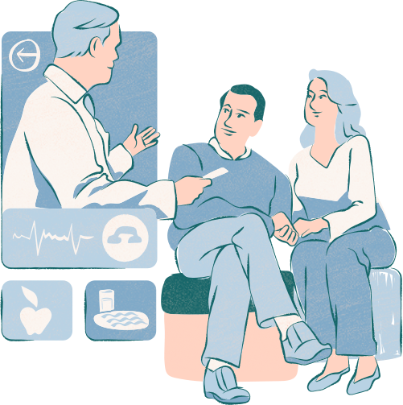
Questions?

Slide 16
References
Beata Strack, Jonathan P. DeShazo, Chris Gennings, Juan L. Olmo, Sebastian Ventura, Krzysztof J. Cios, and John N. Clore, “Impact of HbA1c Measurement on Hospital Readmission Rates: Analysis of 70,000 Clinical Database Patient Records,” BioMed Research International, vol. 2014, Article ID 781670, 11 pages, 2014.
Clore,John, Cios,Krzysztof, DeShazo,Jon, and Strack,Beata. (2014). Diabetes 130-US hospitals for years 1999-2008. UCI Machine Learning Repository. https://doi.org/10.24432/C5230J.
Shaw JA, Stiliannoudakis S, Qaiser R, Layman E, Sima A, Ali A. Thirty-Day Hospital Readmissions: A Predictor of Higher All-cause Mortality for Up to Two Years. Cureus. 2020 Jul 21;12(7):e9308. doi: 10.7759/cureus.9308. PMID: 32839677; PMCID: PMC7440272.

